Slide 1
Complete Study of Factors Contributing to Air Pollution
Deuk Hwan Cho & Kun Woo Kim

Slide 2
Overview
Emerging problems in India

Slide 3
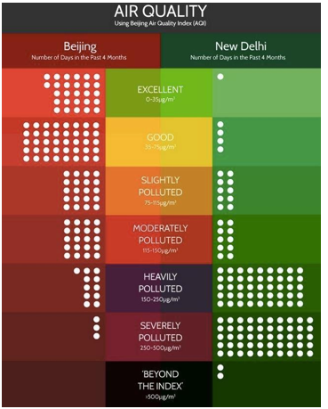
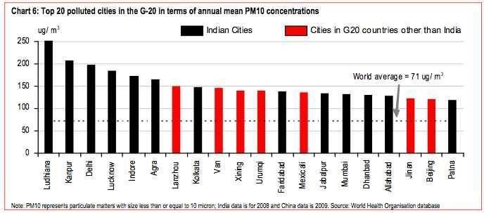
Delhi, the most polluted city
Out of the 20 most polluted cities, 13 are in India

Slide 4
Problem Statement
Studying the data of Air Quality
->identifying patterns/correlating factors on key levels
Understanding behavior of meteorological parameters in the parameters in the planetary boundary layer
->atmosphere is the media governed by the atmosphere

Slide 5
Objective and Scope of the Project
Objective
->identify patterns of spike in Air Pollution levels and meteorological factors to develop a predictive model
Scope
->3 major polluting centers in New Delhi/one year data starting from 4.1.2015
Out of Scope
->Vehicle density during the given period at each location, measuring & monitoring level of road dust, Industrial pollution/one year data starting from 4.1.2015

Slide 6
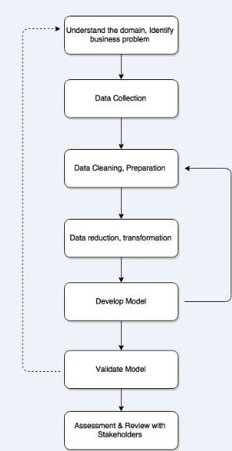
Tools & Techniques
R Programming environment and Microsoft Excel for our analysis and Tableau for data
Box Plot, Histogram, Bar Chart, Line Chart, Infographics, Visual Clues, Correlation Matrix, Multiple Linear Regression, Artificial Neural Network

Slide 7
Exploratory Data Analysis
Data Analysis

Slide 8
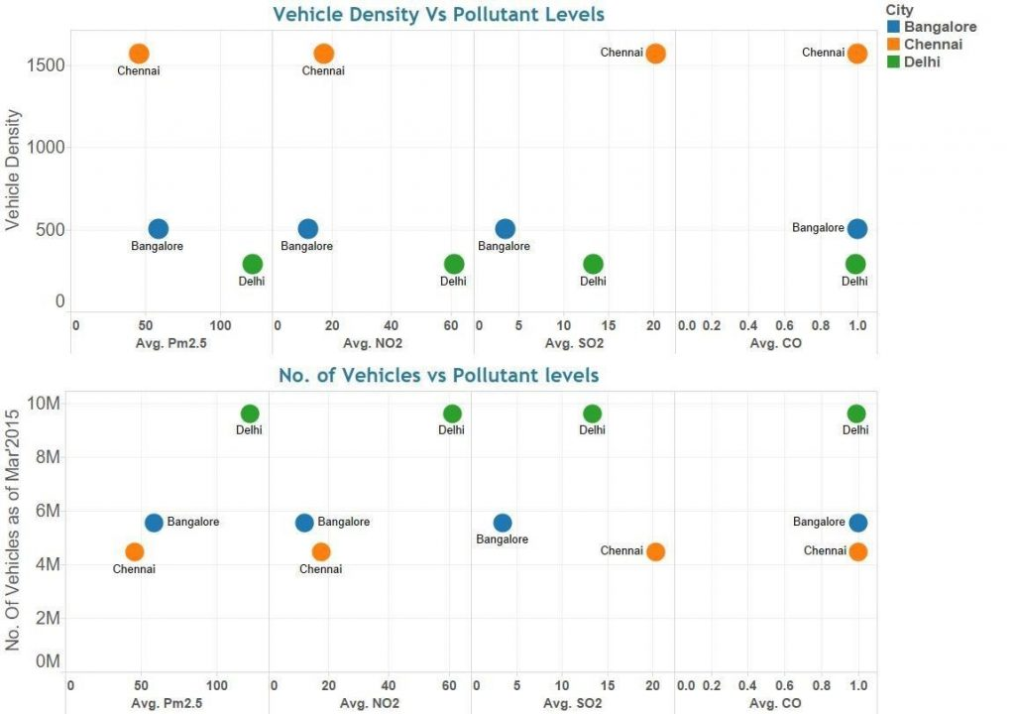
Analyzing the impact of Vehicle Density & Vehicle Population
positive correlation between the number of vehicles/air pollution levels of PM 2.5 & to a lesser extent on NO2.
CO levels does not seem to have any correlation with either vehicle density or with vehicle population
factors, other than vehicular pollution, contributing to the overall air pollution in the three cities are almost equal
->vehicle density contribute high air pollution levels.

Slide 9
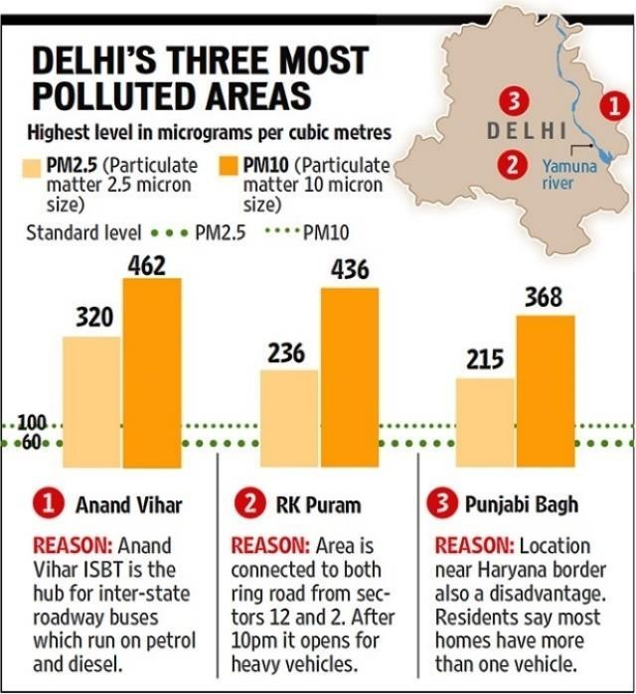
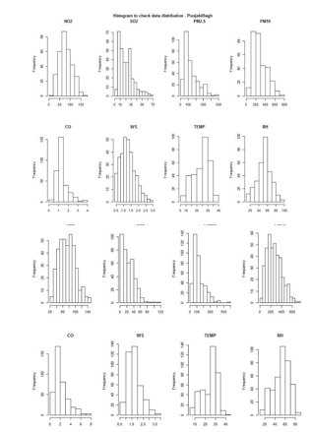
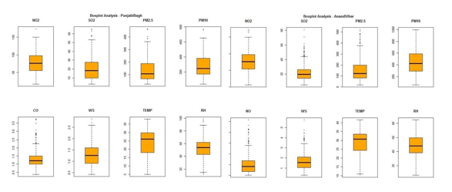
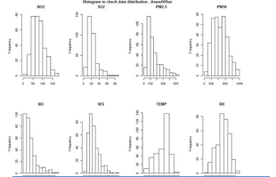
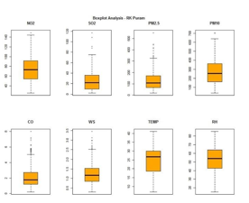
Identifying Patterns for Air Pollution in New Delhi

Slide 10
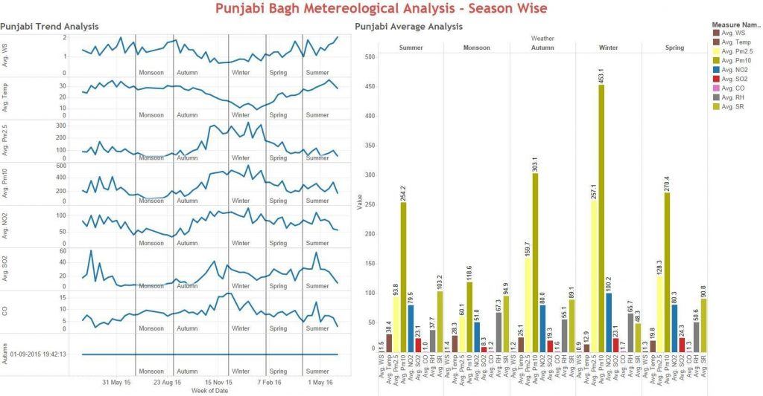
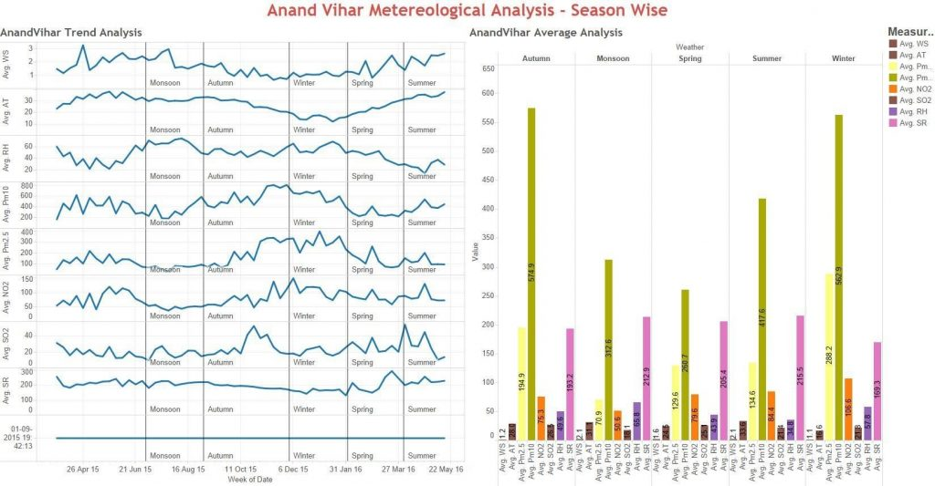
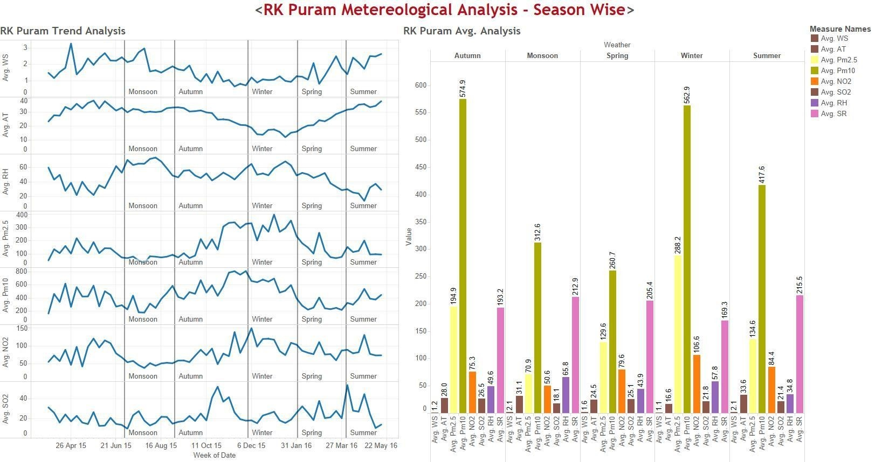
Seasonality Analysis : Conclusion

Slide 11
Seasonality Analysis : Conclusion
Relatively lower Pollution levels seem to be associated with higher Wind Speed
Very low Atmospheric Temperature is associated with relatively higher Pollution levels of PM 2.5/PM 10
Other pollutants data remains significantly same throughout the year except for NO2

Slide 12
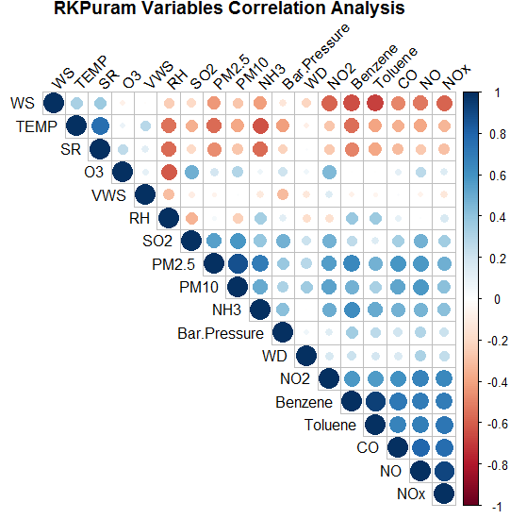
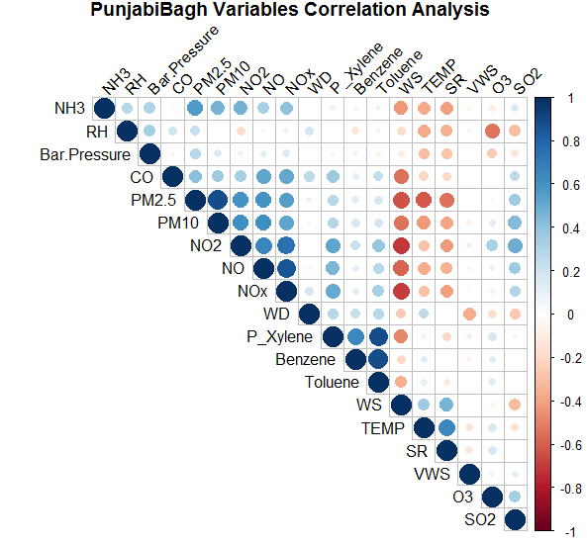
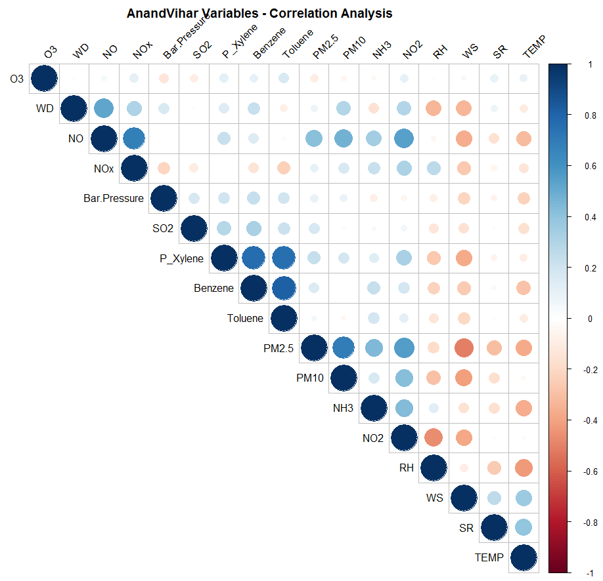
Correlation Matrix & Analysis

Slide 13
Predictive Model Development
4 different models

Slide 14
Predictive Model Development
Multiple Linear Regression Model (MLR)
& Neural Network Model (NN)
: using one additional variable(Previous Day level for that particular Pollutant) with the actual available variables)
Notes:
MLR: statistical technique that uses several explanatory variables to predict the outcome of a response variable.
NN: simplified model of the way the human brain processes information.

Slide 15
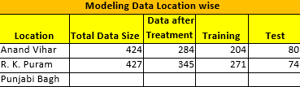

Slide 16
Analyzing Data Sets
the objective is to predict the value of next day
Included Multiple Linear Regression which was run on Train data set using R package data of past days
Using replacement of extreme data

Slide 17
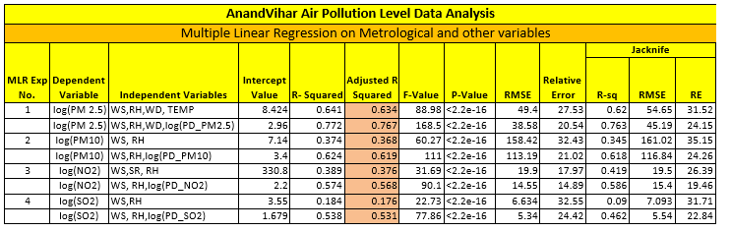
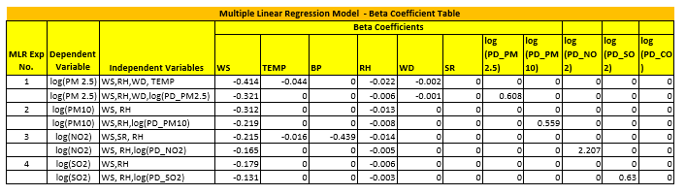
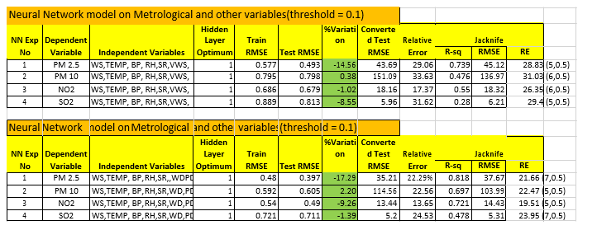

Slide 18
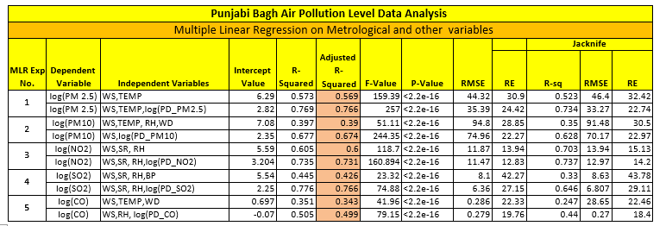
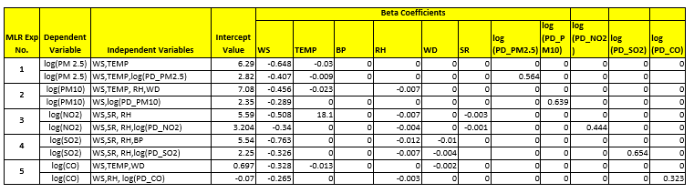
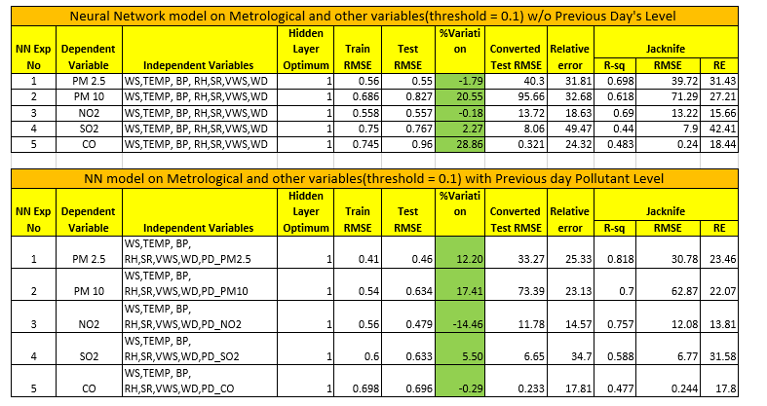

Slide 19
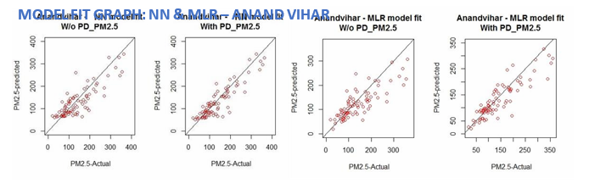
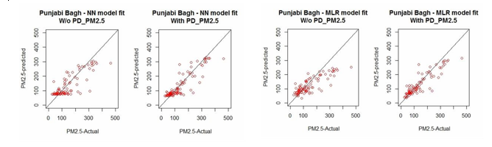
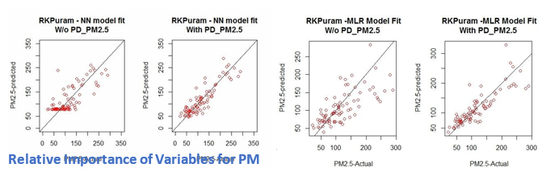

Slide 20
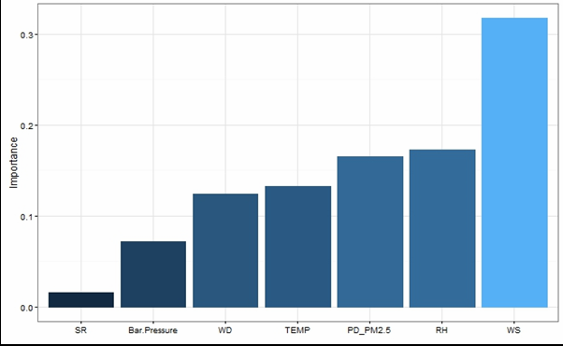
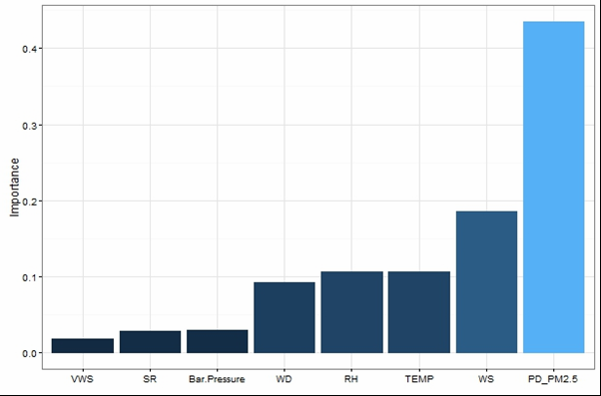
Result

Slide 21
Model Validation
Jackknife Validation Method

Slide 22
Model Validation
Use Jackknife Validation Method for validating the 4 Models
Root Mean Square Error (RMSE) Value method to validate and compare the relative performance of the 4 Model
Notes:
Jackknife: cross-validation technique first developed by Quenouille to estimate the bias of an estimator.
RMSE: measures how much error there is between two data sets. compares a predicted value and an observed or known value.

Slide 23
Inference
Model built with Previous Day’s value provides the lowest Relative error
Neural Network gives the lowest Relative Error in prediction
Only for Punjabi Bagh PM 2.5, SO2 & Anand Vihar NO2, SO2 MLR provides lower Relative error.

Slide 24
Predictive Model Development Conclusions
Multiple Linear Regression Model is able to explain almost 76% of variations in PM 2.5
Wind Speed seem to be the most important independent variable followed by the Value of Previous Day
Model Fit seem to be significant for PM 2.5 for both the models across
Overall Neural Network Model was able to relatively perform better as compared to Multiple Linear Regression Model for predicting many pollutants

Slide 25
Thank you very much
References:
https://www.analyticsvidhya.com/blog/2016/10/complete-study-of-factors-contributing-to-air-pollution/
https://www.ibm.com/support/knowledgecenter/en/SS3RA7_15.0.0/com.ibm.spss.modeler.help/neuralnet_model.htm

